Slide 1

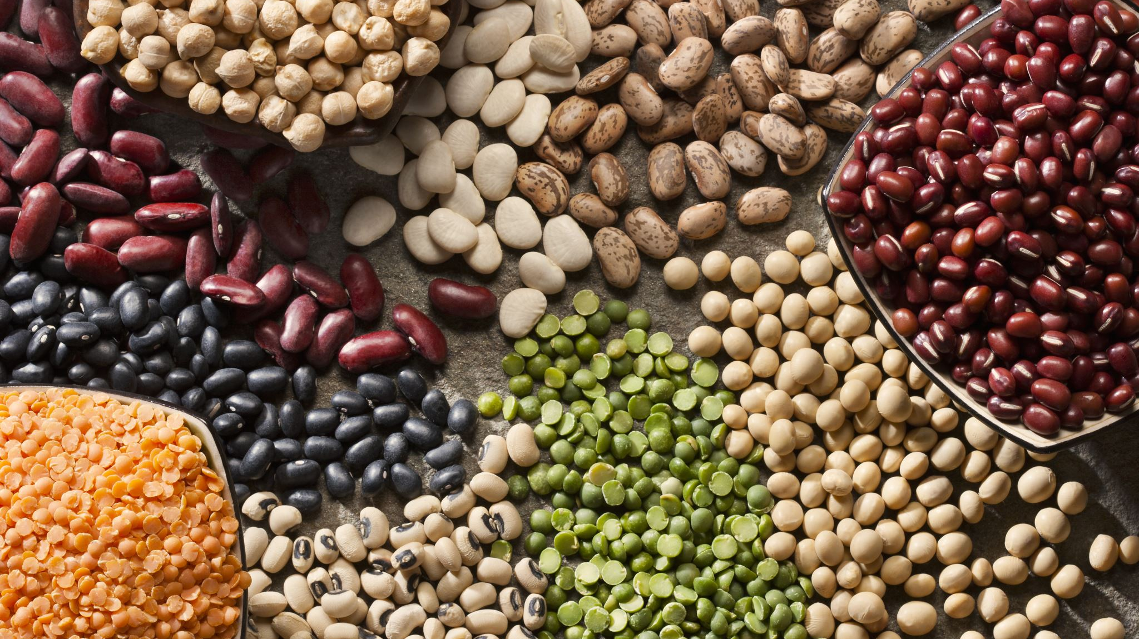

Dry Beans Dataset
Student: Khudayar Farmanli (s276310)
Mathematics IN Machine Learning

Slide 2
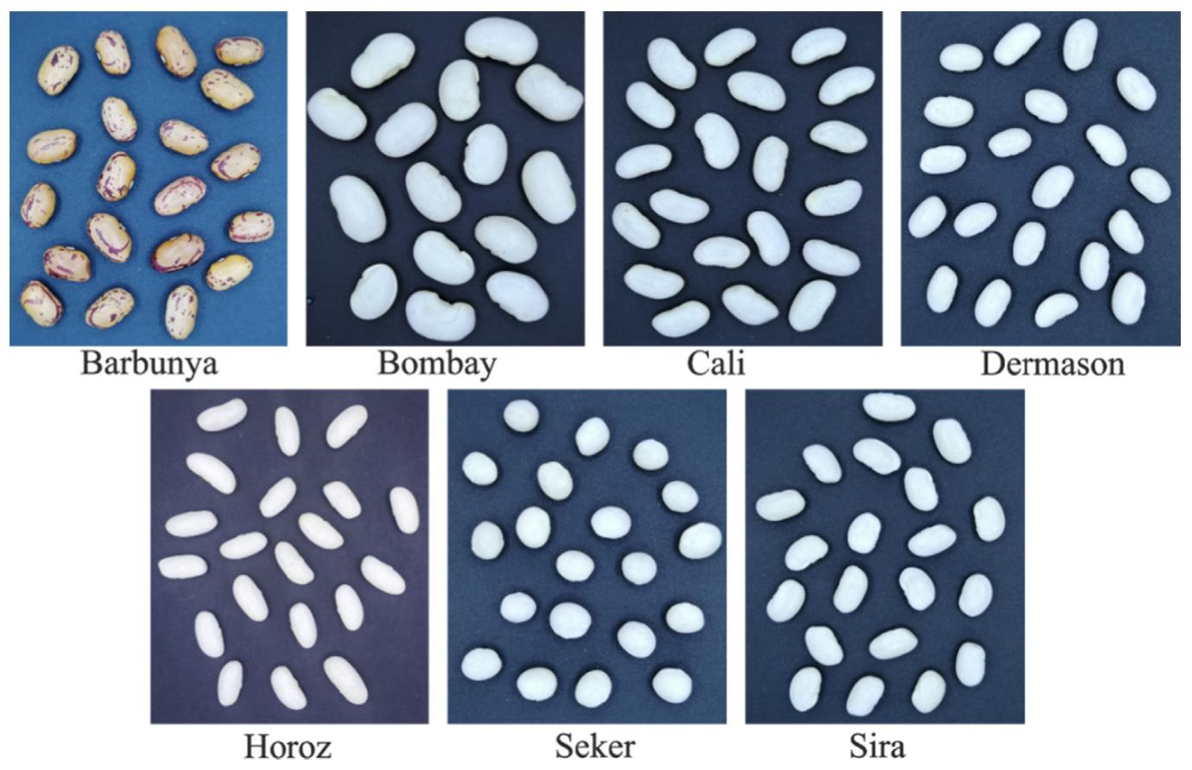
Dataset description
For classification model, images of 13,611 grains of 7 different registered dry beans were taken with a high-resolution camera.
A total of 16 features were obtained; 12 dimensions and 4 shape forms.

Slide 3
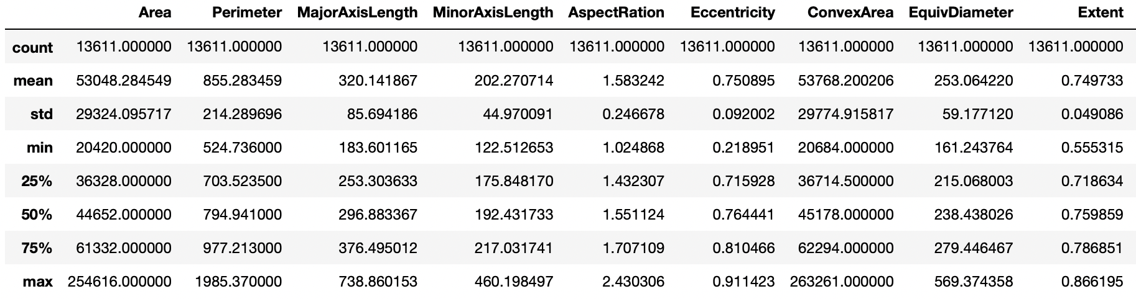
Dataset description
Some Statistical data for some of the features

Slide 4
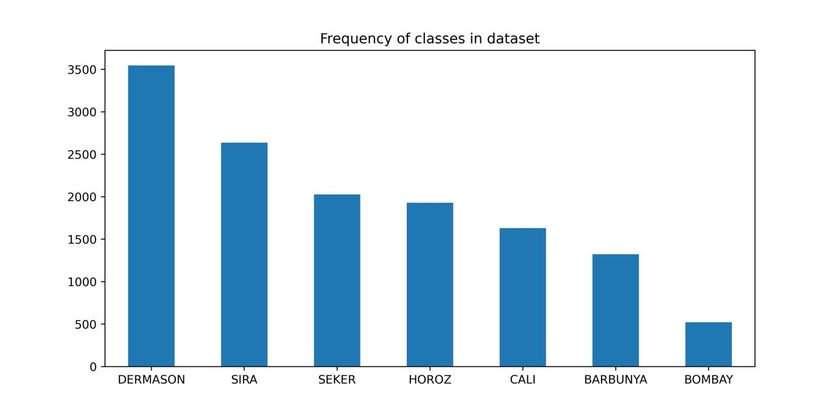
Data Exploration
Number of Null values is 0.
We have imbalanced dataset as it can be observed from the Figure.

Slide 5
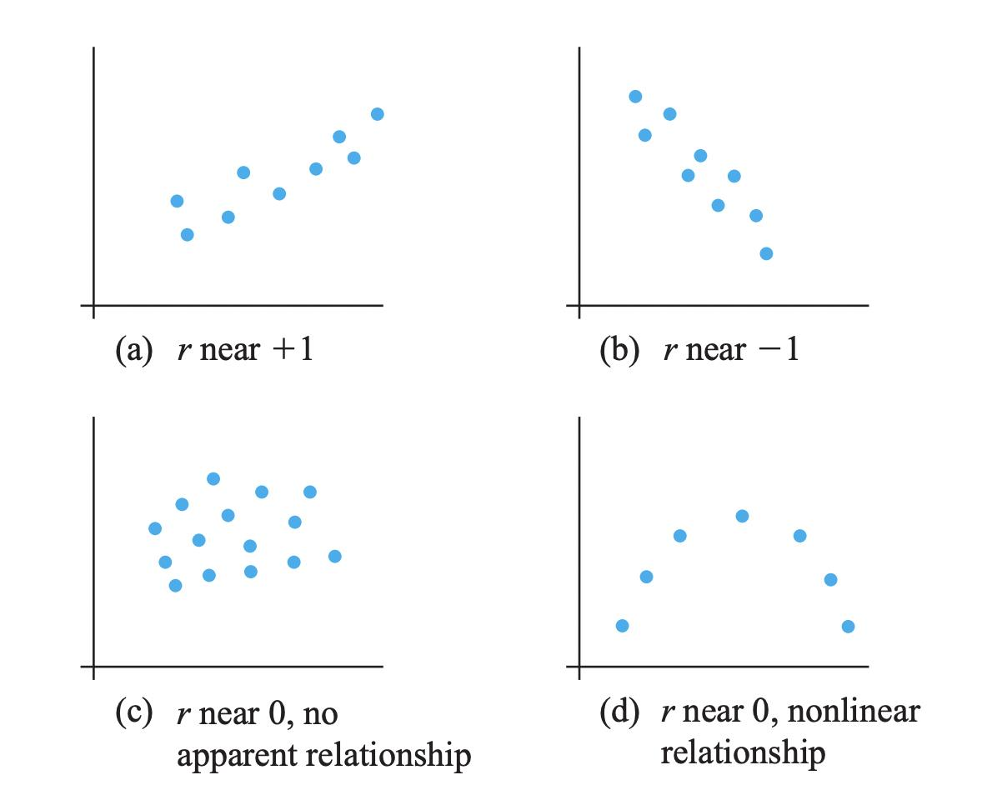
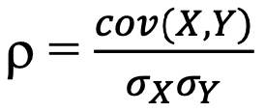
Correlation
Correlation is very useful way to understand linear relationship between two features and in case of high correlation, eliminate one of them.
Pearson Correlation was used in our case:

Slide 6
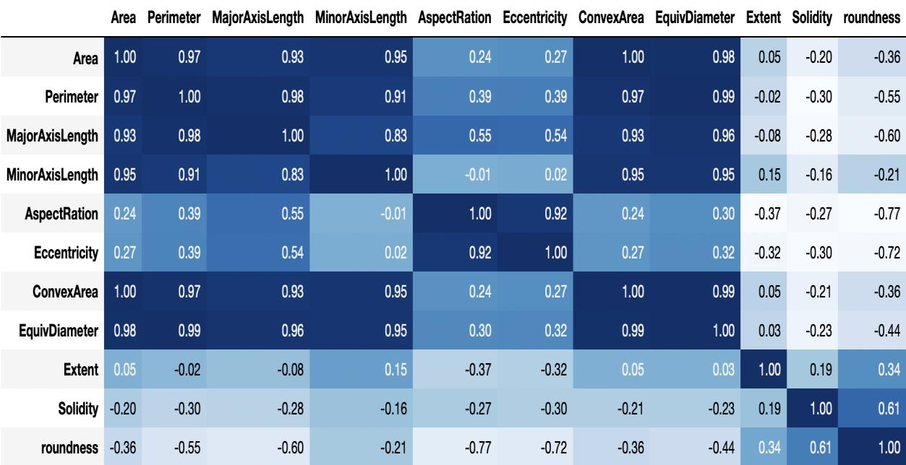
Correlation
Correlation between some features of Dry Bean Dataset

Slide 7
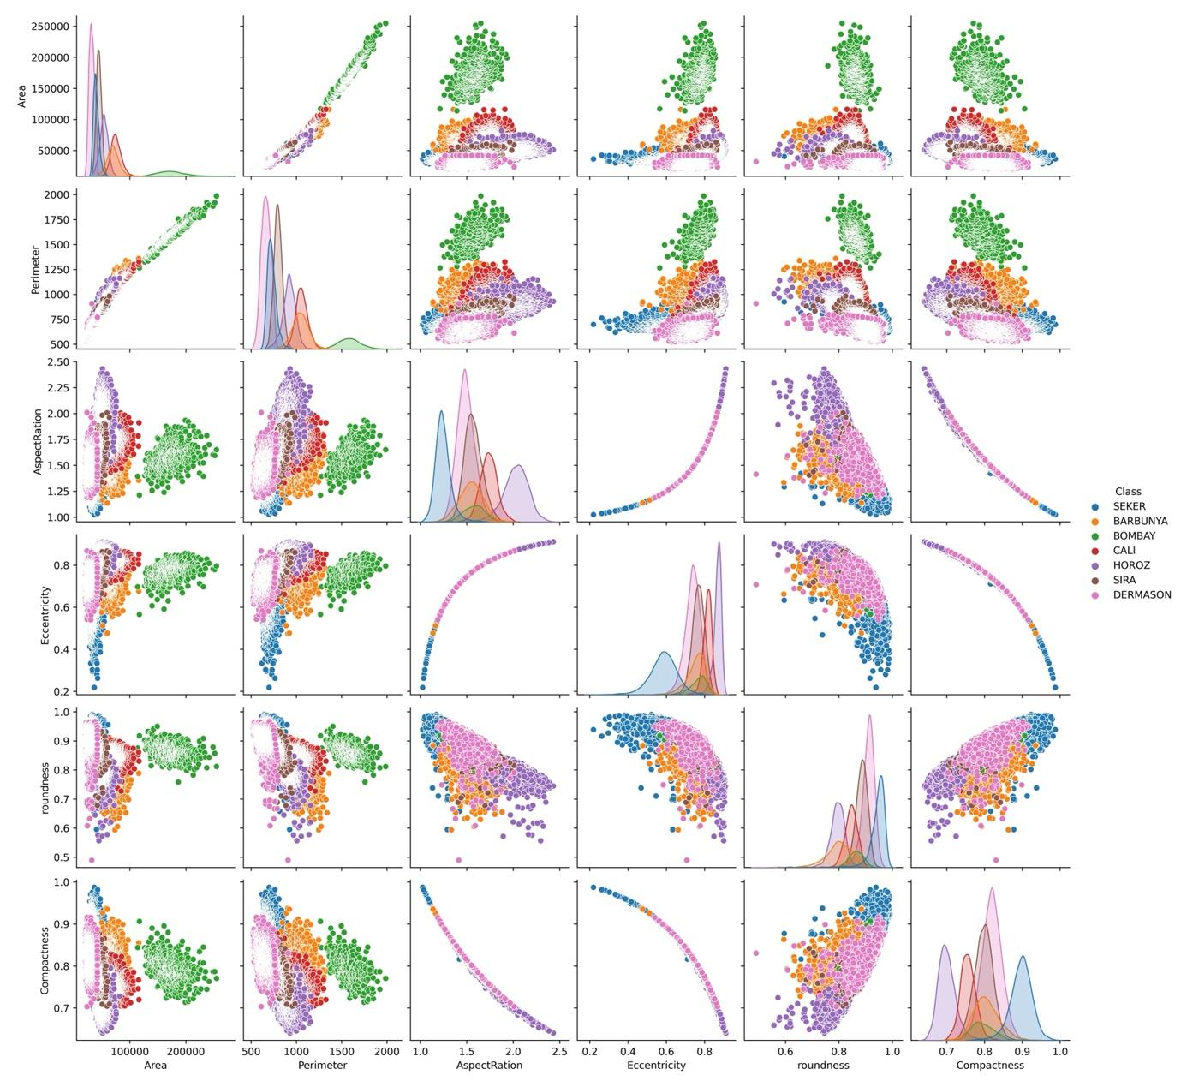
Correlation
Another way of seeing the relationship between two variables visually is use of Pairs Plots from Seaborn library

Slide 8
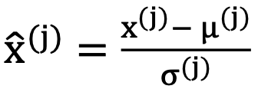
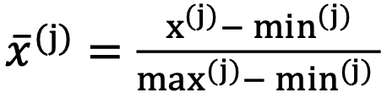
Data Preparation - Standardization
Many machine learning algorithms perform better when numerical input variables are scaled to a standard range. For instance, k- nearest neighbors which is using distance measure to assign class while classifying. Also, it is important step to apply before PCA.
Most popular techniques are:
-Standardization (or z-score normalization, also the one we use for our case).
-Normalization.

Slide 9
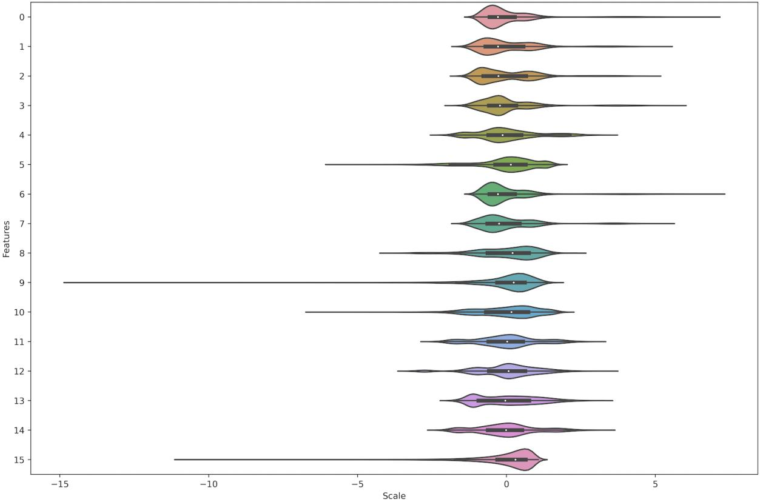
Data Preparation - Standardization
Violin plots after applying Standard Scaler

Slide 10
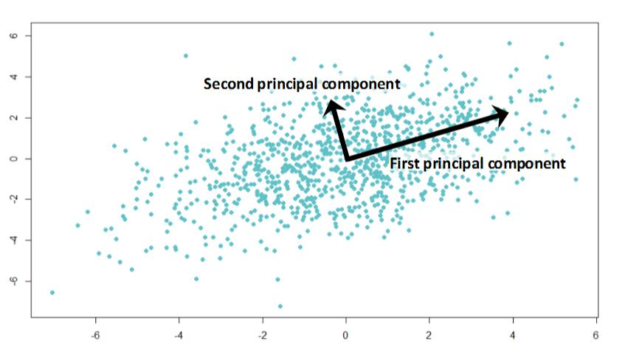
Data Preparation - PCA
Principal Component Analysis is technique which is used to remove redundant or highly correlated features, also reduces the noise in the data.

Slide 11
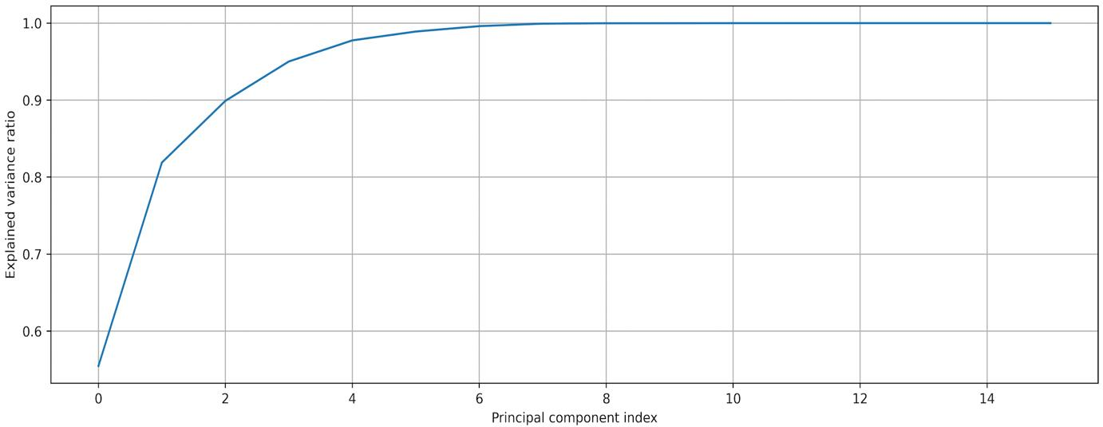
Data Preparation - PCA
Cumulative some of principal components for our Dry Bean dataset.

Slide 12
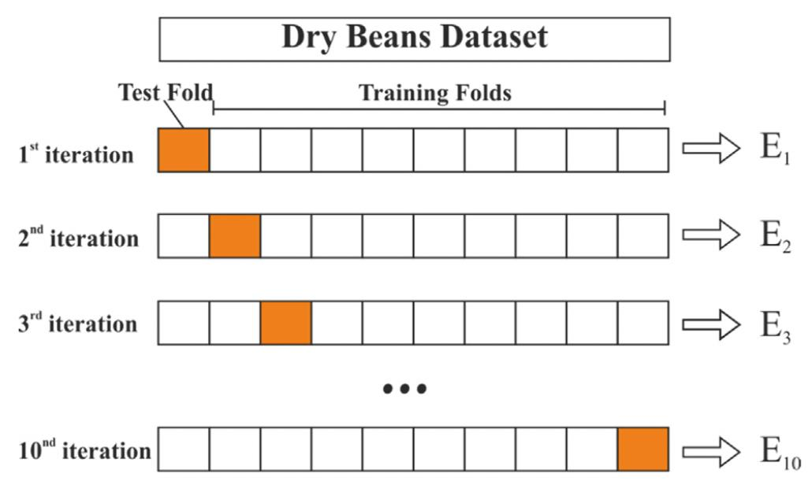
Settings & Metrics – Cross Validation
Cross Validation is a method developed to increase the security of classification in which we randomly split our training set into several subsets (k folds) of the same size.
Unlike Hold-out method which only splits dataset into training and test set, cross validation is more computationally time demanding task but at the same time less dependent on test set like its counterpart.

Slide 13
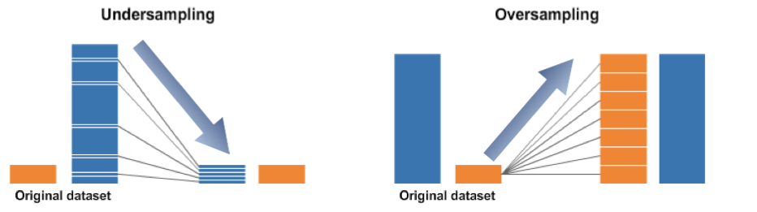
Settings & Metrics – Smote Oversampling
While working with imbalanced data, we should take into consideration that most of the classification algorithms are sensitive to make predictions for the benefit of majority class and biased towards minority class. For addressing this issue, we can use one of the Oversampling and Undersampling techniques.

Slide 14
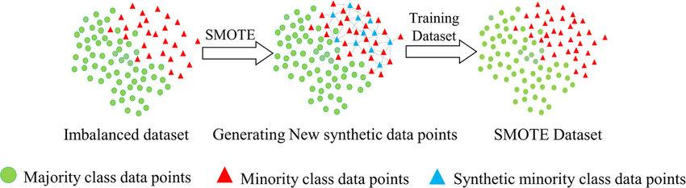
Settings & Metrics – Smote Oversampling
Our particular technique for imbalancing issue is SMOTE (Synthetic Minority Oversampling Technique). Smote first selects a random example from the minority class. Then k of the nearest neighbors for that example are found. A randomly selected neighbor is chosen, and a synthetic example is created at a randomly selected point between the two examples in feature space.

Slide 15
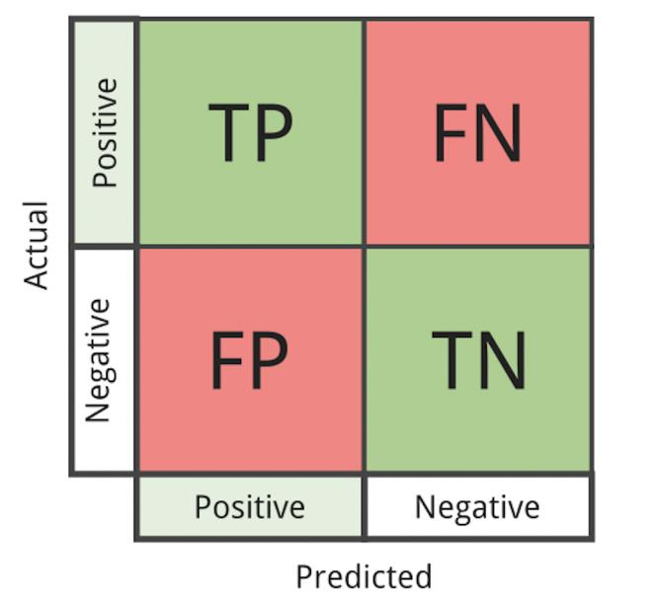
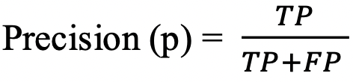
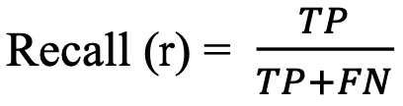
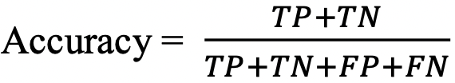
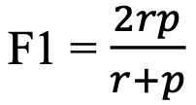
Settings & Metrics – Model Performance Assessment
Precision:
Recall:
Accuracy:
F1 score:

Slide 16
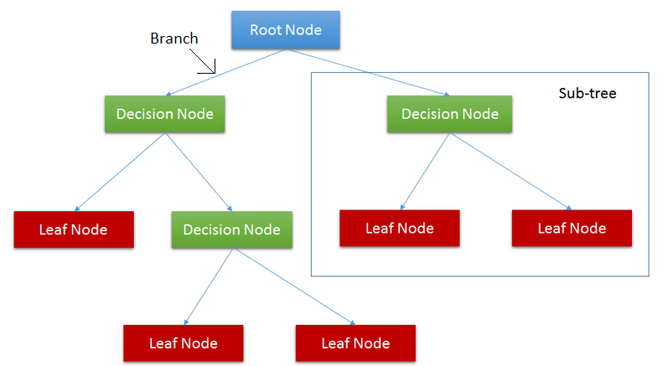
Model Selection – Decision Tree
A Decision Tree is an acyclic graph that can be used to make decisions.
In each branching node of the graph, a specific feature j of the feature vector is examined. If the value of the feature is below a specific threshold, then the left branch is followed; otherwise, the right branch is followed. As the leaf node is reached, the decision is made about the class which the example belongs.
Nodes splitted based on Gini or Entropy

Slide 17
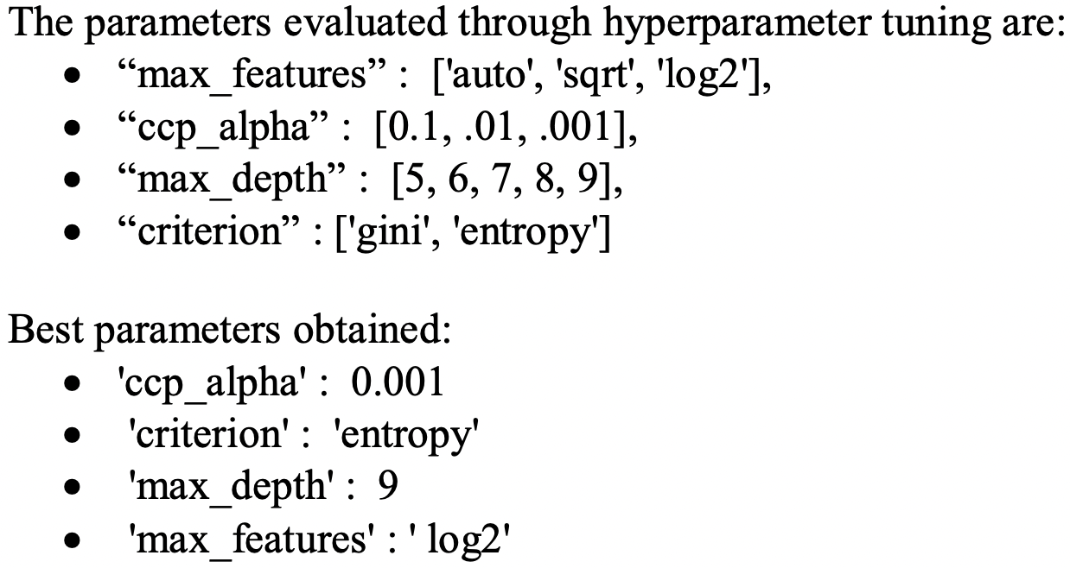
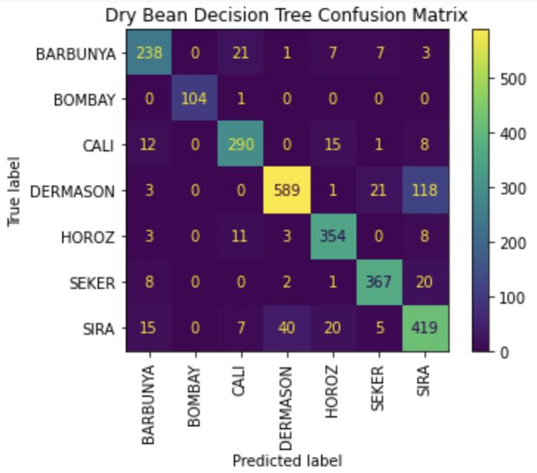
Model Selection – Decision Tree

Slide 18
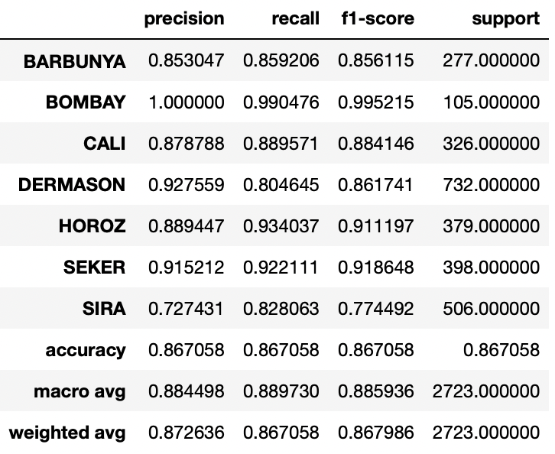
Model Selection – Decision Tree
Decision tree classification report

Slide 19
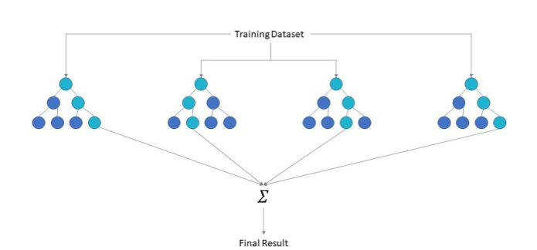
Model Selection – Random Forest
Random Forest is ensemble learning algorithm, and it is simply set of decision trees. Some number of decision trees are built at training time and the class assigned by majority voting. Random Forest is based on the idea of Bagging which consist of creating many “copies” of training data (each copy is slightly different from another) and then apply the weak learner (decision tree in our case) to each copy to obtain multiple weak models and then combine them.

Slide 20
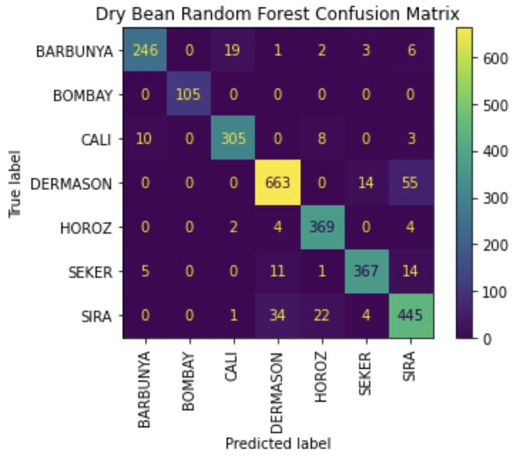
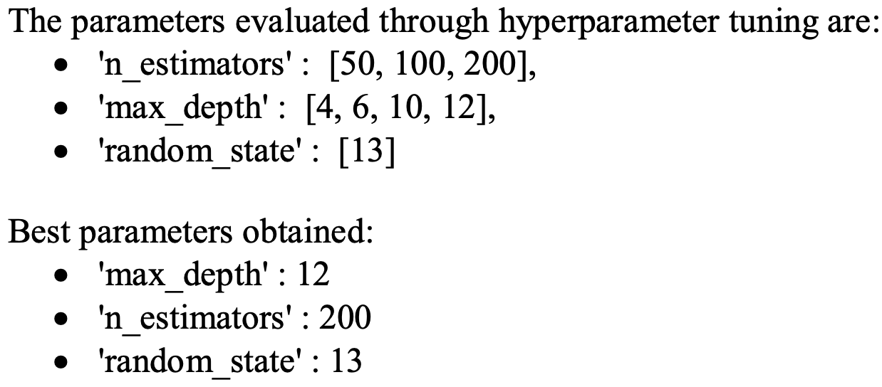
Model Selection – Random Forest

Slide 21
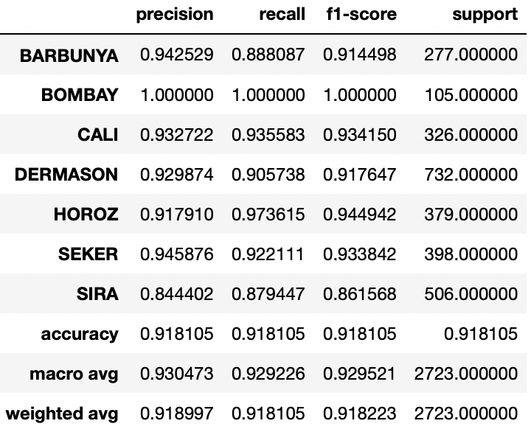
Model Selection – Random Forest
Random Forest classification report

Slide 22
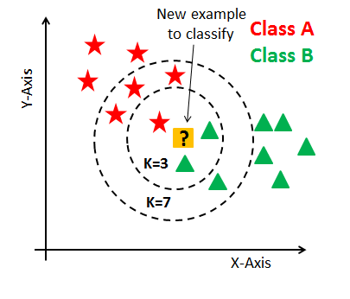
Model Selection – K-Nearest Neighbor (KNN)
KNN is a non-parametric learning algorithm. Contrary to other learning algorithms that allow discarding the training data after the model is built, KNN keeps all training examples in memory. Once a new, previously unseen example x comes in, the KNN algorithm finds its k training examples closest to x and return the majority label, in case of classification. The closeness of two examples is given by a distance function. As distance function generally, Euclidean distance is preferred.

Slide 23
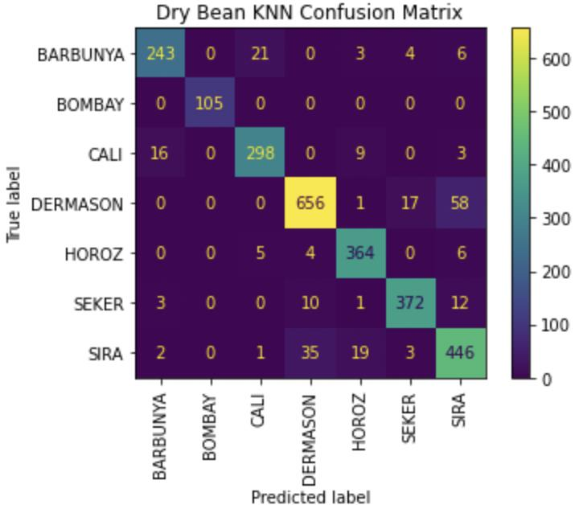
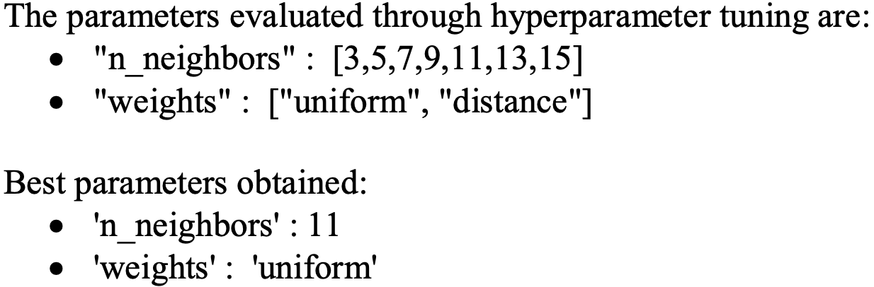
Model Selection – K-Nearest Neighbor (KNN)

Slide 24
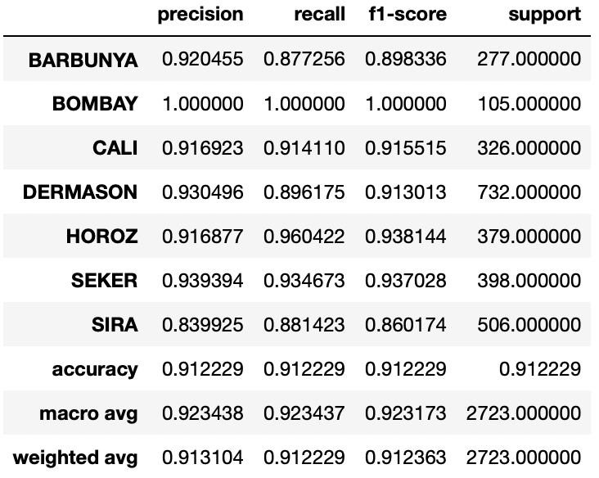
Model Selection – K-Nearest Neighbor (KNN)
KNN classification report

Slide 25
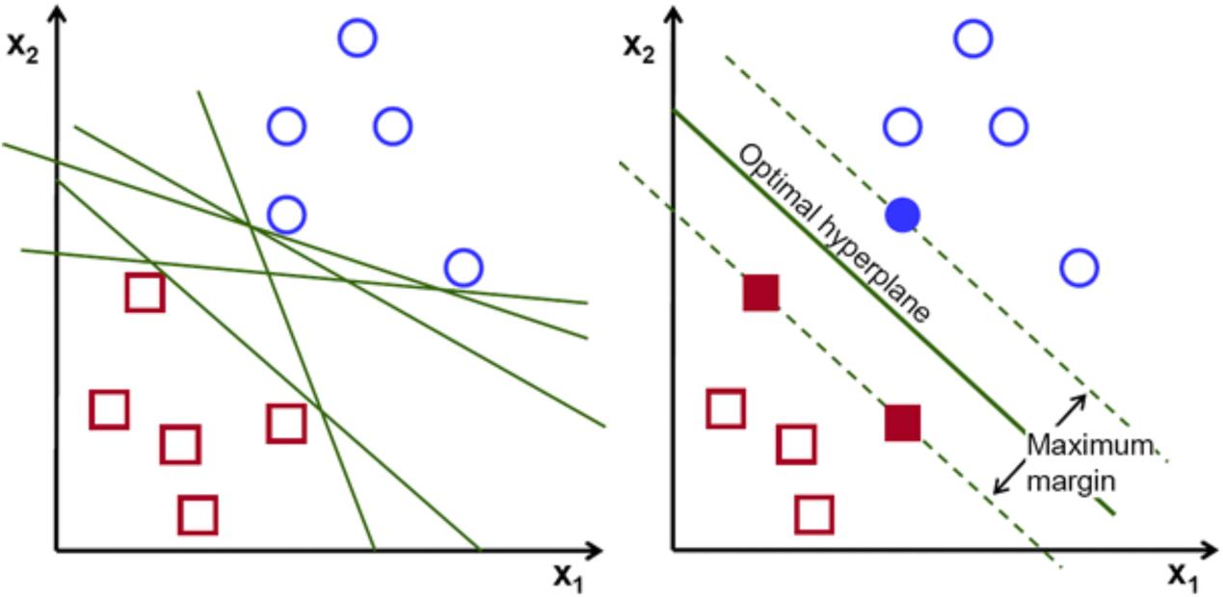
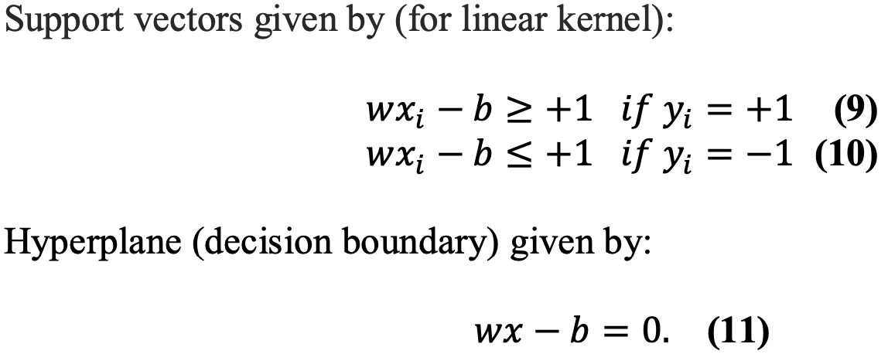
Model Selection – Support Vector Machine (SVM)
The objective of the SVM algorithm is to find a hyperplane in an N-dimensional space (where N is the number of features) that distinctly classifies the data points. For separation there are many hyperplanes that can be chosen but we aim to get the one with maximum margin.

Slide 26
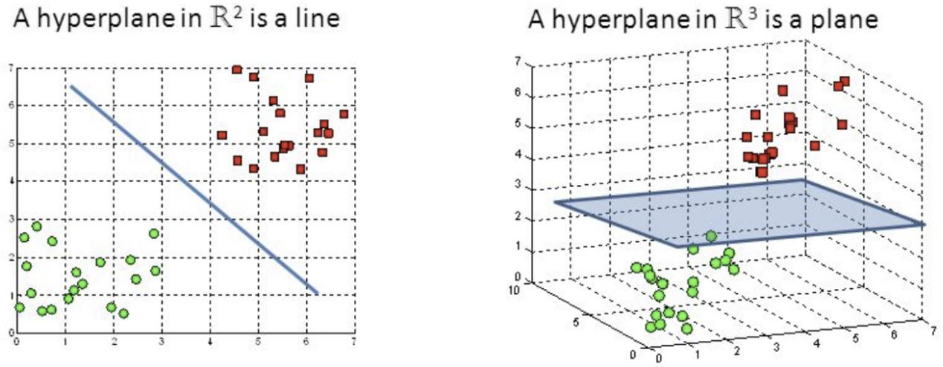
Model Selection – Support Vector Machine (SVM)
Hyperplanes in different feature spaces

Slide 27
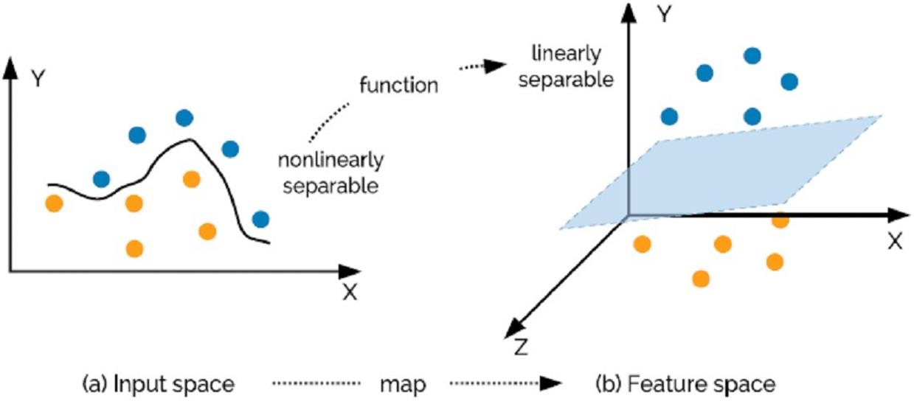
Model Selection – Support Vector Machine (SVM)
SVMs can also classify nonlinear data by moving the data to a higher size by a method called kernel trick. Usually, data that cannot be separated linearly in the original input space can be separated in high dimensional feature space

Slide 28
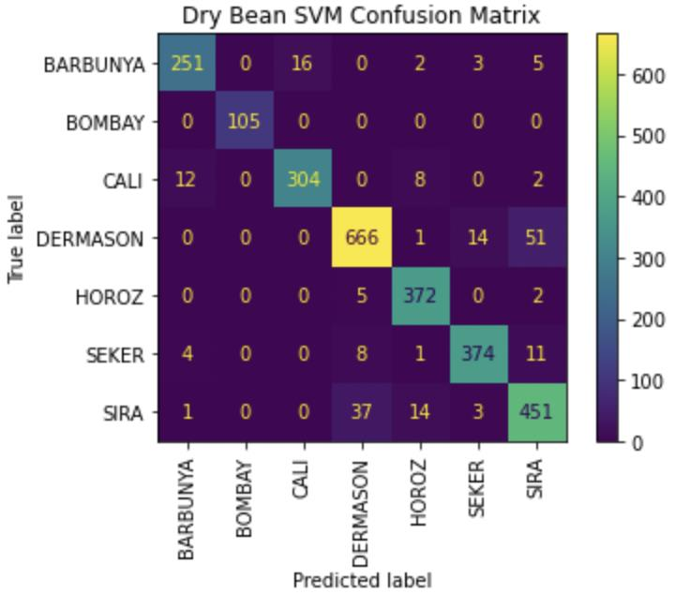
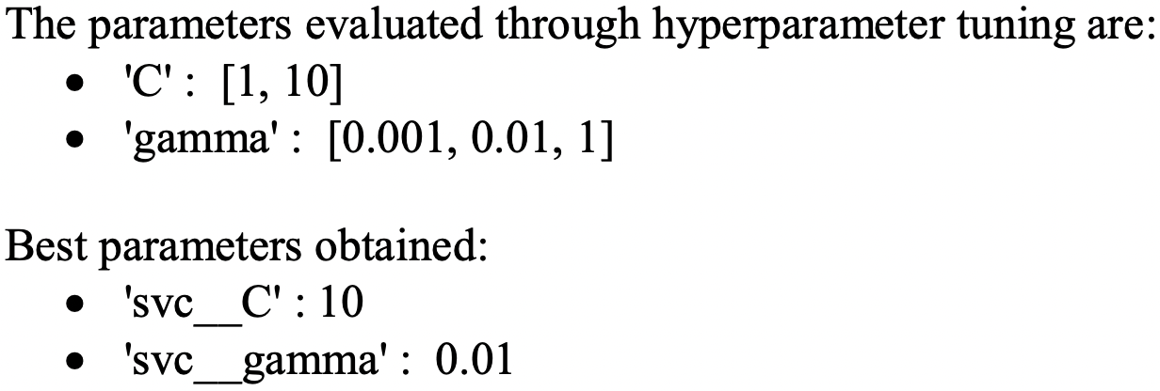
Model Selection – Support Vector Machine (SVM)

Slide 29

Model Selection – Support Vector Machine (SVM)
SVM classification report

Slide 30
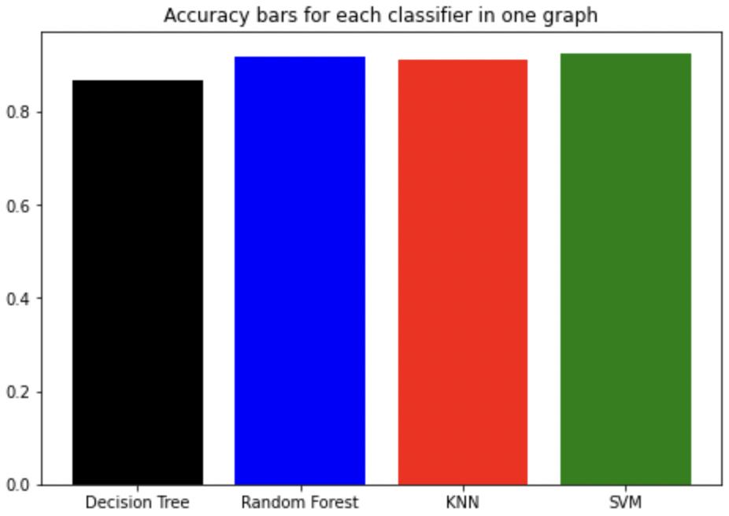
Conclusion
From the Figure we can see how models performed in terms of Accuracy. Best performance belongs to SVM and the least one is Decision tree but overall all of them were successful. Roughly, all the results in terms of other metrics overlapped and this shows the data distribution is regular.
Mostly Sira and Dermason varieties mixed with each other by classifiers, because of their similar shapes.
Almost in every case Bombay classified totally right, only Decision tree performed 99%, others did 100%.

Slide 31

Thanks for attention!

